Slide 1
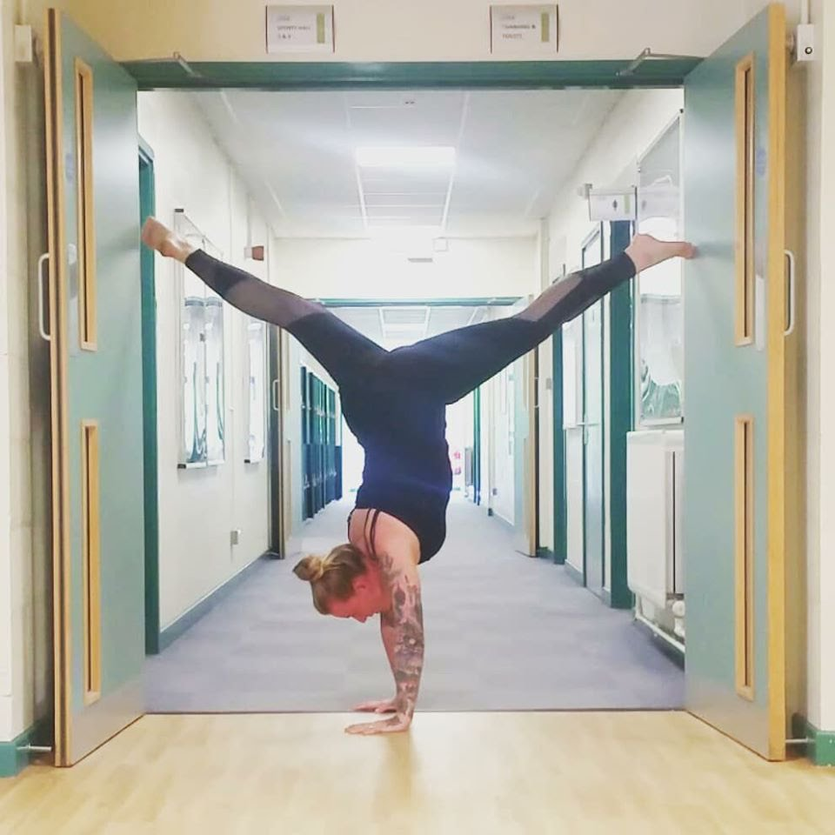
Sports Facilities
Ambleside
Carlisle
Lancaster
Notes:
Welcome to UoC Active. The home of Sport and Recreation at the University of Cumbria

Slide 2
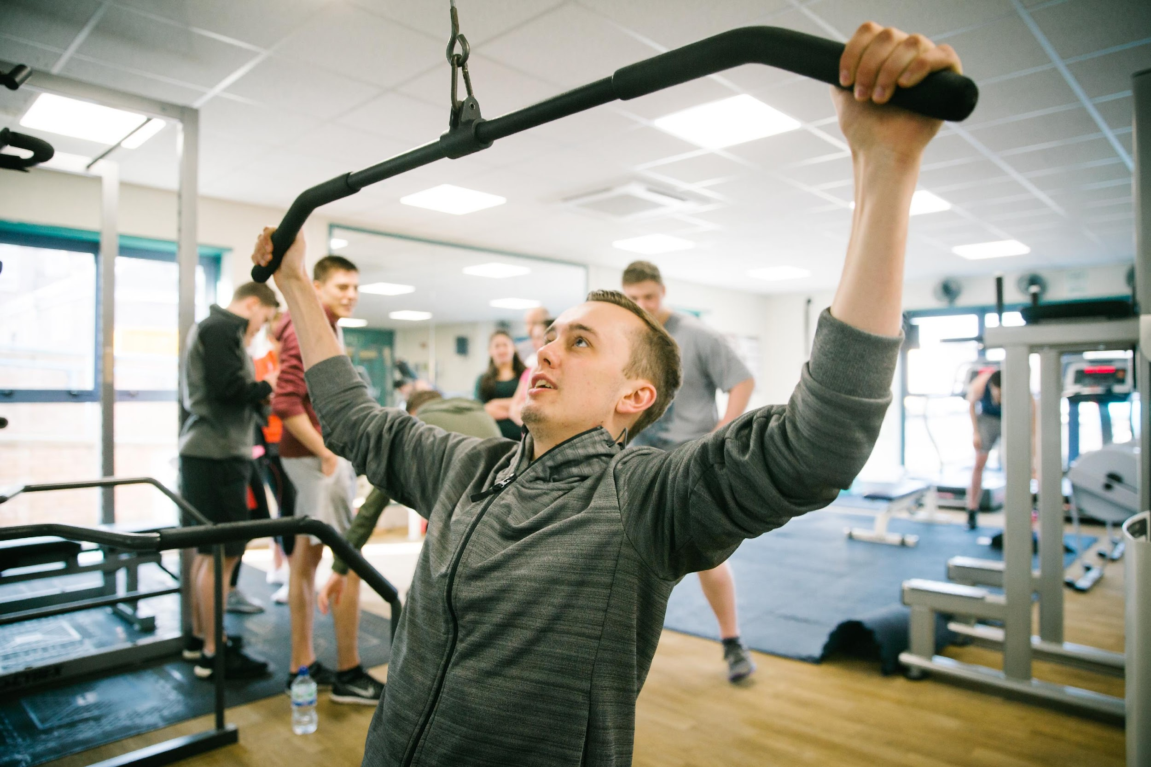
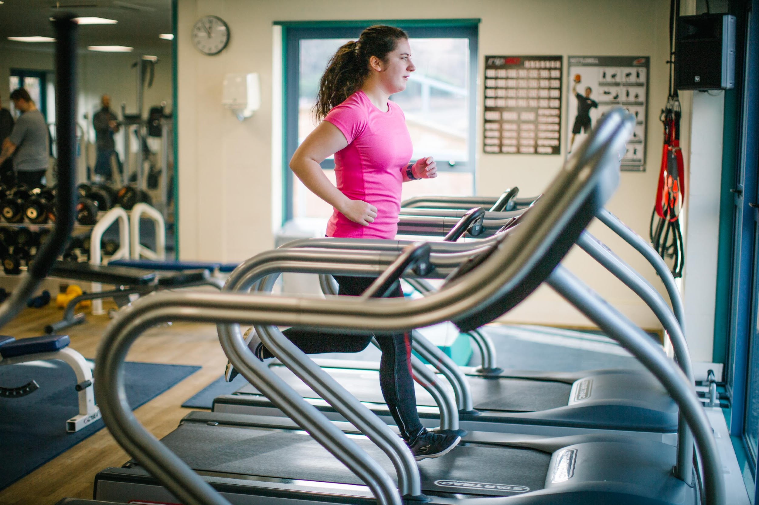
What is UoC Active?
UoC Active was formed with the main aim to create a healthy University for our students, staff and local communities
Our mission is to make sport and exercise as inclusive as possible
It encompasses all of the sporting opportunities at the University. Students Union sports clubs, facilities, CPD courses and community activities which provide both paid and volunteering opportunities
Notes:
Statement to be read out to display our values
Combination of our Academic sport. Facilities, Student union
Provide sporting opportunities to students our Carlisle, Ambleside and Lancaster Campuses.
Take a moment to share with you our sports facilities, activities and membership offers available to you.

Slide 3
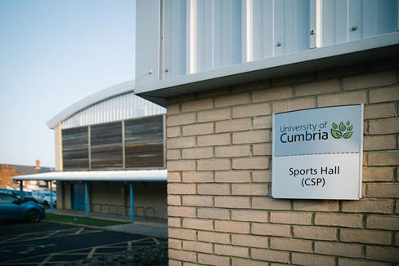
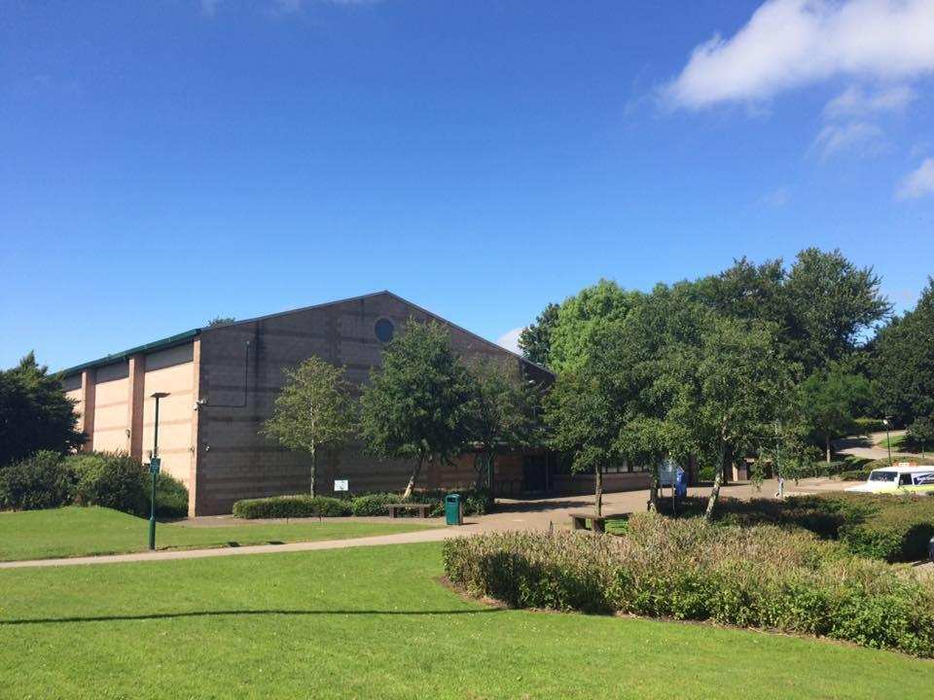
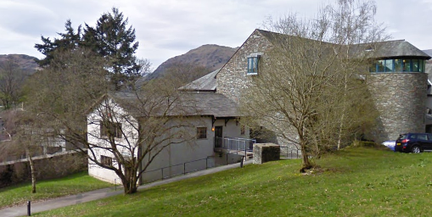
Sports Facilities
Carlisle
Lancaster
Ambleside
Notes:
This is what our facilities look like on Campus.
Point out location in cities
Ambleside campus with gorgeous view of the struggle (you can add your own lake district knowledge here)
Close to halls of residence

Slide 4
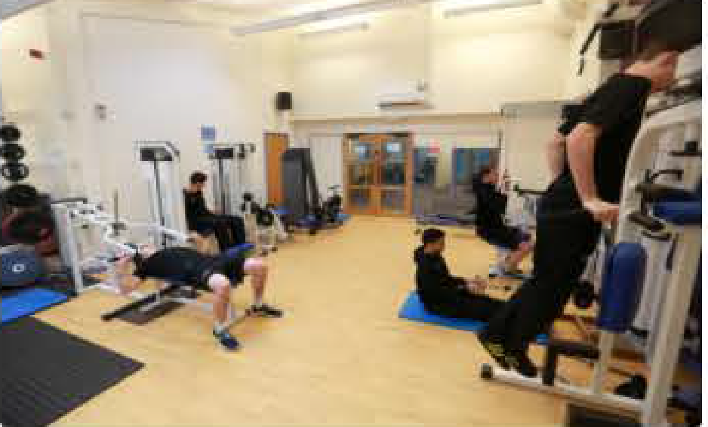
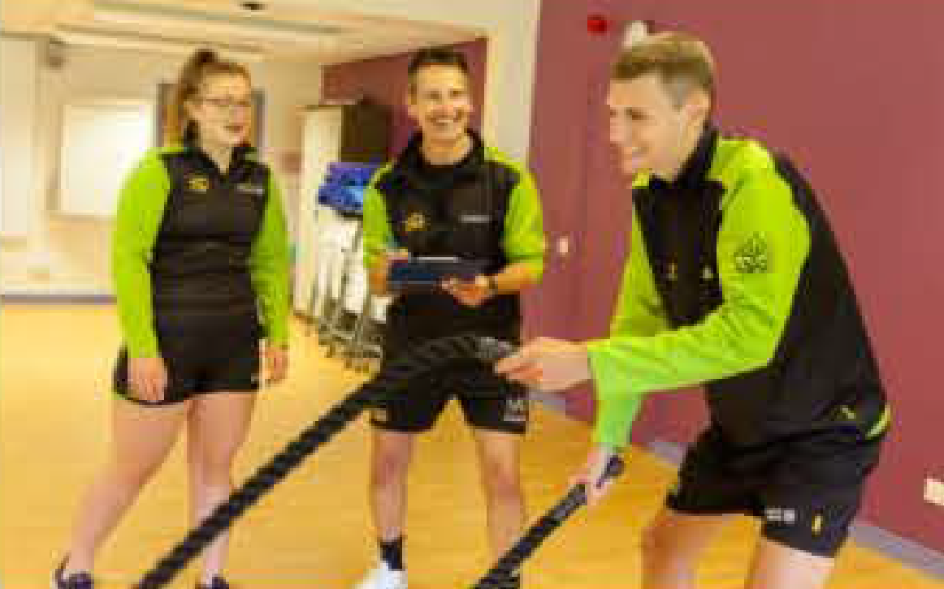
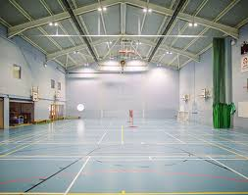
Lancaster Facilities
Large Multi-purpose Sports Hall
Available for variety of activities including:
Badminton
Football
Basketball
Netball
Gymnastics
Athletics
Dance
Gym Facilities
Air- conditioned Fitness Suite Equipped with:
Rowing Machines
Treadmills
Exercise Bikes
Cross Trainers
Upper and lower body resistance Machines
Selection of free weights
Medicine balls
Power Cage and weight bars
Dual Cable Machine
Fitness Classes & Activities Available Throughout the week
Yoga
Pilates
Circuits
Boot Camp
Zumba
Step
Notes:
Having a wide range of facilities enables us to be closely engaged with many local clubs playing football, hockey, badminton and an extremely successful Gymnastics/Trampolining programme.
Provide students with opportunities to be involved with our facilities such as casual work and volunteering
Whether that’s working in the Sports Complex, running our Summer Activities club or taking part in team matches.
We also offer Award programmes in various Sports, Fitness and First Aid courses.

Slide 5
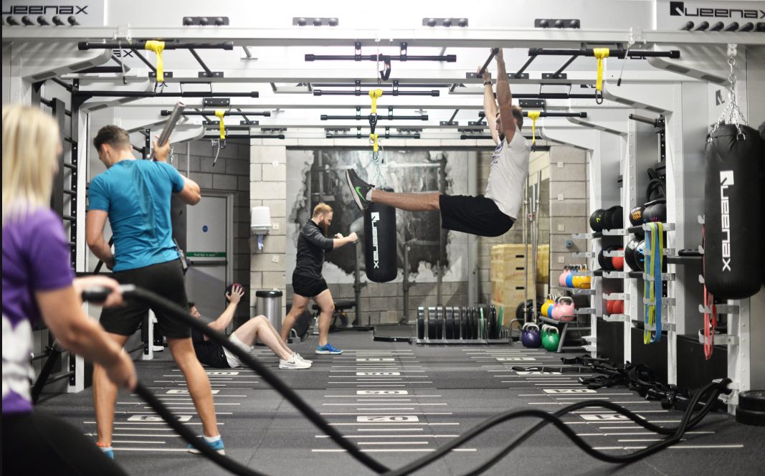
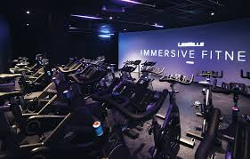
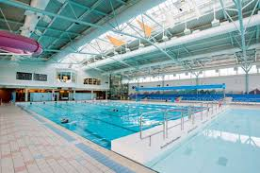
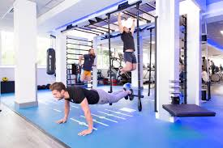
Salt Ayre
Membership includes the use of all facilities at Lancaster City Councils Salt Ayre Leisure Centre, which include:
State of the Art Health and Fitness Suite
33 Metres Swimming Pool
Over 150 Fitness Classes
Steam Suite
Athletics Track
Indoor Sports Hall
Outdoor Grass Pitch
Immersive Cycle Studio
Training Zone and Functional Training Area
Notes:
Student Membership also entitles you to also use the fantastic facilities on offer at the Salt Ayre Sports Centre, which is a short trip from our Lancaster campus.
Salt Ayre has recently undergone a exciting £5m development project, which has seen many areas refurbished as you can see on the images.
Salt ayre now boast additional facilities such as an XHeight indoor climbing wall, XGravity outdoor flight tower and a Beauty and Spa area.

Slide 6
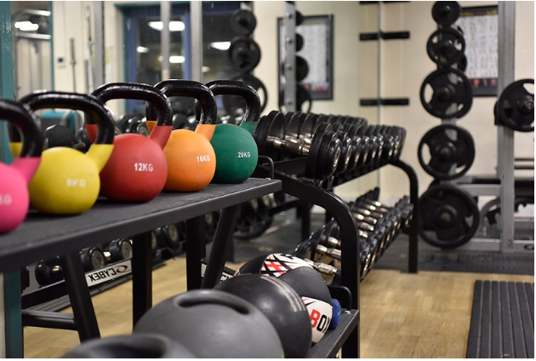
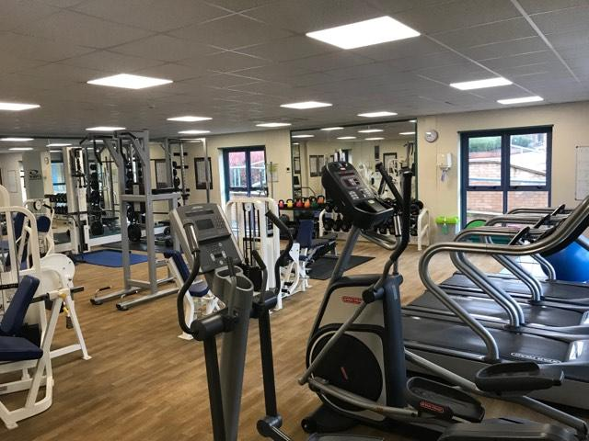
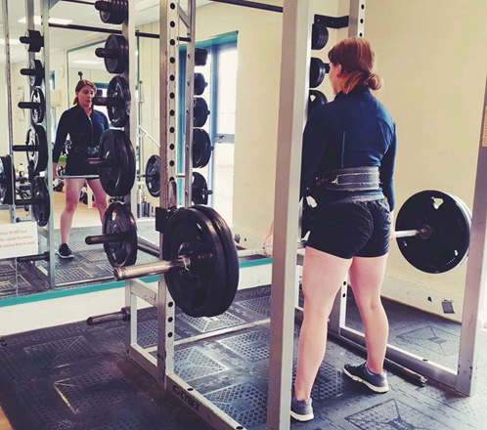
Carlisle Facilities
Fusehill Street Campus
Gym Facilities
Air- conditioned Fitness Suite Equipped with:
Rowing Machines
Treadmills
Exercise Bikes
Cross Trainers
Upper and lower body resistance Machines
Selection of free weights
Kettlebells
Medicine balls
TRX Suspension Equipment
Power Cage and weighted bars
Dual Cable Machine
Large Multi-purpose Sports Hall
Available for variety of activities including:
Badminton
Futsal
Basketball
Netball
Fencing
Gymnastics
Athletics
Dance
Fitness Classes & Activities Available Throughout the week
Metafit
Dance
Boxercise
Yoga
Running
Circuits
Futsal
Badminton
Basketball
Netball
Notes:
If you are planning on studying in Carlisle, we also have a very similar range of facilities on campus that you get access to.
Like Lancaster campus, Carlisle also provide students with opportunities to be involved with our facilities such as casual work and volunteering
Alongside their fantastic membership package, Carlisle offer a number of free events and activities on campus for you to join in with.
We have a Sports Rehabilitor on site who was once a university of Cumbria Sports Rehabilitation Student. Now running his own business in partnership with UoC Active.

Slide 7
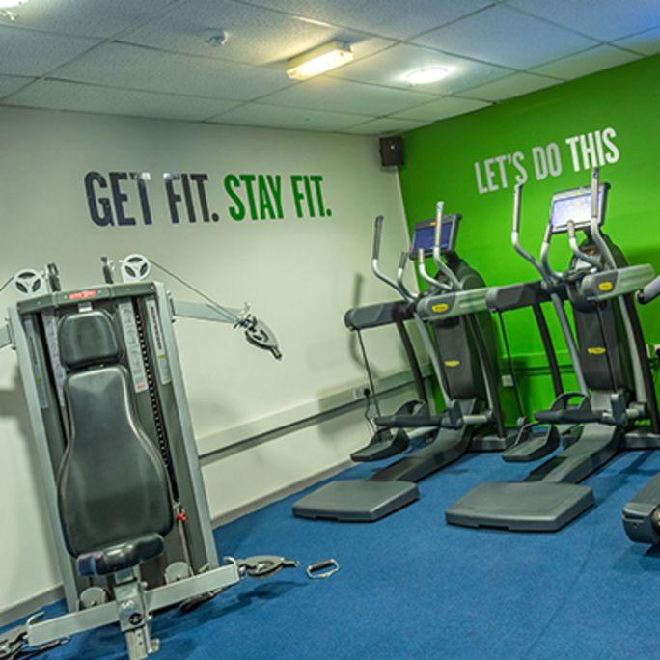
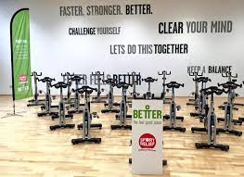
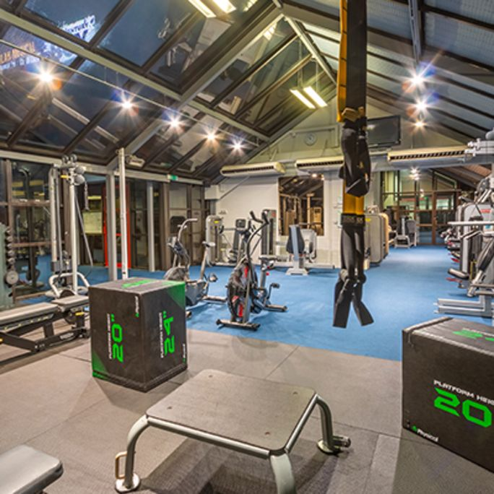
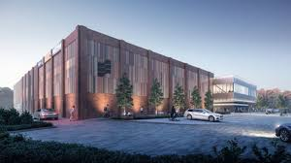
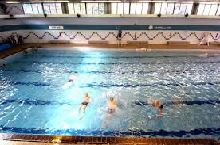
GLL Better Leisure
Student membership packages also benefit from access to Better Leisure facilities across Carlisle and West Cumbria including:
• The Sands Centre,
• Morton Pool and Fitness Centre
• The Pools
• Bitts Park Tennis & Recreation Area
• Sheepmount Athletics Stadium
• Keswick Leisure Centre
• Cockermouth Leisure Centre
• Workington Leisure Centre
better.org.uk/carlisle
Notes:
Like Lancaster, Carlisle also has a fitness partnership that gives students even more opportunities to take part in sport and physical activity with better Leisure.
Within the facilities listed above, these offer:
Unlimited Gym Use
Fitness Classes
Badminton
Squash
Swimming Facilities
These facilities are scattered throughout Carlisle and West Cumbria, meaning wherever you live there is always a facility close by to use.
Comment on existing facilities at sands then move to Image of sands. Better leisure are also in the process of redeveloping their fitness facilities in the centre of Carlisle to a new multi-million pound facility. This is expected to be available in the near future…

Slide 8
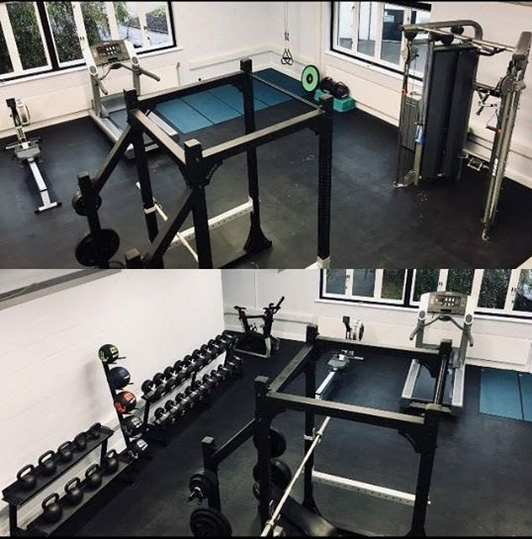
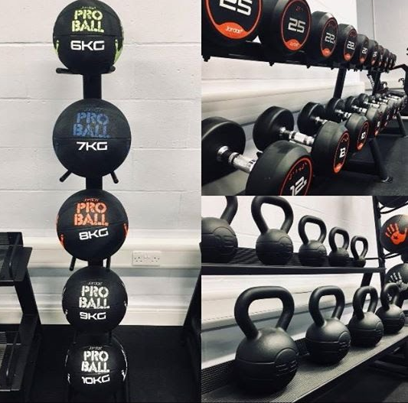
Ambleside Gym Facilities
Gym Facilities
Swipe Access Fitness Suite Equipped with:
Rowing Machine
Treadmill
Watt Bike
Selection of Free Weights
Kettlebells
Medicine balls
TRX Suspension Equipment
Power Cage and weighted bars
Dual Cable Machine
Fitness Classes & Activities Available Throughout the week:
Pilates
Small Group Training
Table Tennis
Bouldering Wall
Outdoor activities including water sports with the lake district national park on your doorstep!
Notes:
Set with beautiful views at the top of our Ambleside Campus. This is the newest fitness facility being recently refurbished in Summer 2018.
Comment on a few pieces of equipment and the fantastic view from the treadmill
The equipment in the facility was stocked based upon student feedback, to create a functional training environment for them all to enjoy. Sense of ownership and input into the facility working with the UoC Active Team
We offer a number of small based group training classes and pilates (outdoors on a nice day) that students can book onto. With the Lake district national park on your doorstep the number of outdoor activities students can engage in are endless!

Slide 9
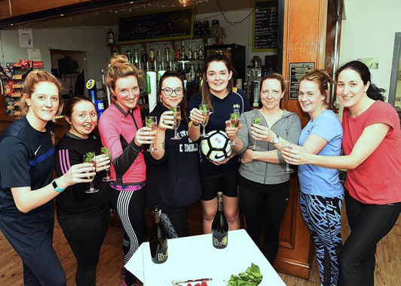
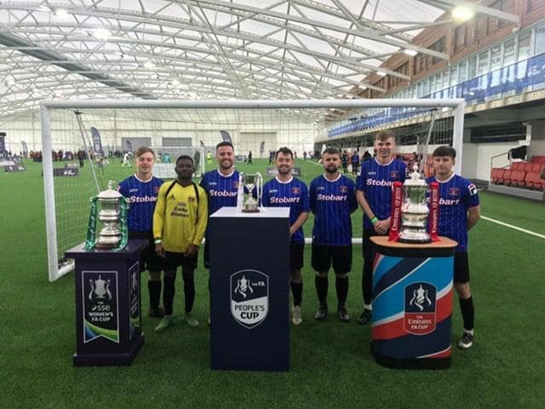
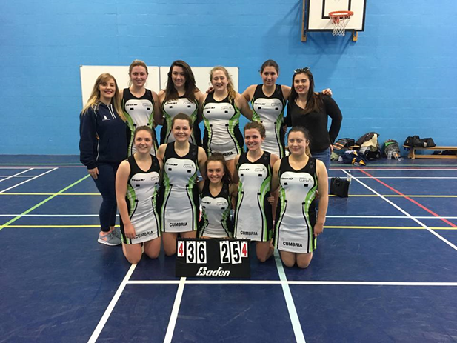
Student Sports teams and Groups
Student Union groups and teams use the sports facilities for both training and competitive fixtures.
The BUCS fixtures take place on Wednesday afternoons against other Universities, UoC teams have previously included:
Mens/Women’s Football
Women’s Netball
Mens and Women's Hockey
Mens Badminton
Women’s Rugby
Mens Table Tennis
Anyone can start a Students Sports Group/Society!
For more details on additional groups please speak to the Student Union.
Notes:
Read top line….then examples of some of the groups mentioned in the elist (mention fencing in particular in Carlisle as quite unique)
Anyone can start a Students Sports Group/Society with funding available from the SU
FA peoples cup finals day and project as an example of some of our success
Students also participate in some of our local grassroots leagues (Carlisle City Sunday League football)
Student activators employed to deliver sessions such as our Football Activator project ran in partnership with the FA and BUCS
Our Student groups are ran by the students for the students (chairman, treasurer, captain etc).
We work closely with the student union in supporting you and assisting with facilitating your Training & fixtures. Including free training facility use, Match day venues, Referee’s and more.

Slide 10
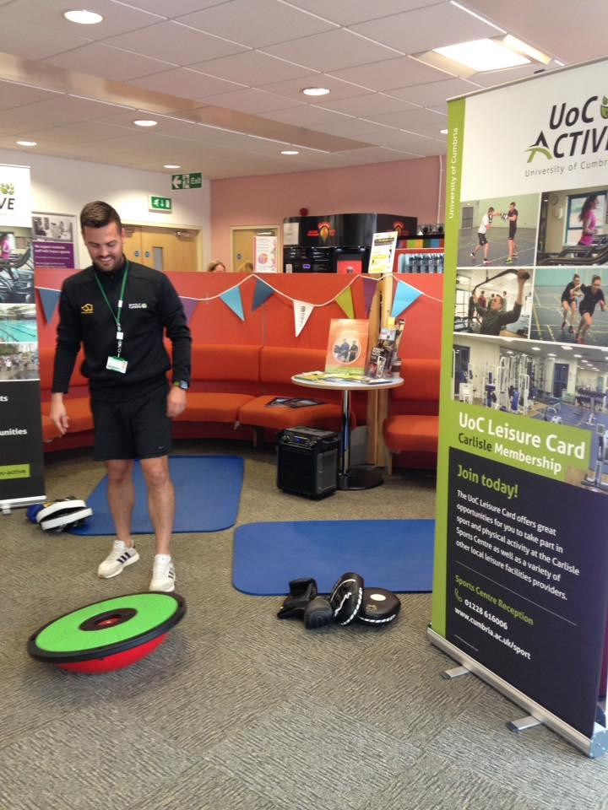
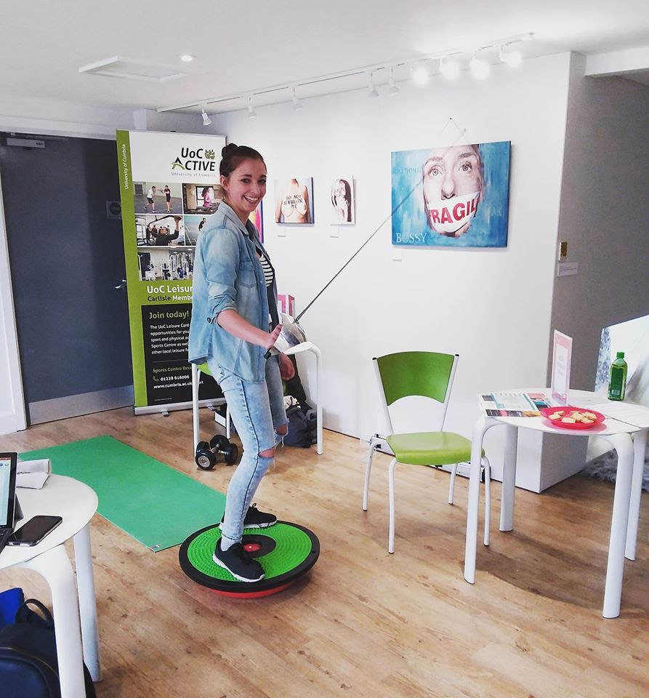
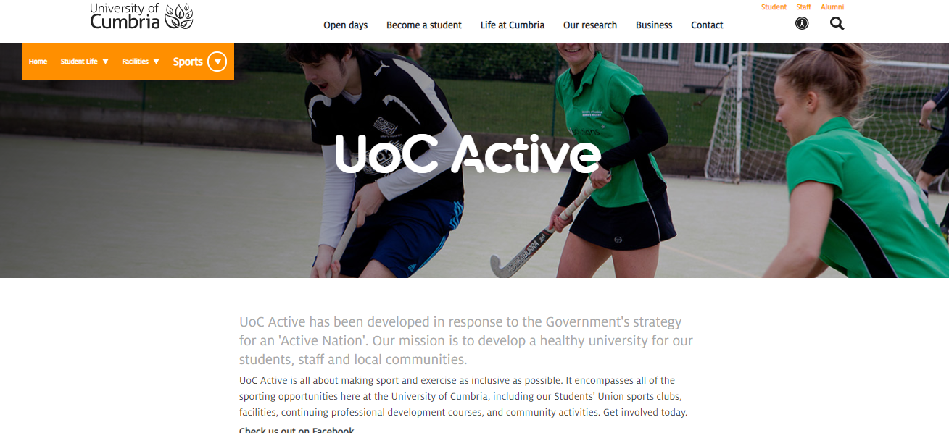
More Information…
Carlisle Sports Centre
Carlisle Sports Centre
Fusehill Street
Carlisle
CA1 2HH
Phone: 01228 616006
Email: carlislesportscentre@cumbria.ac.uk
Lancaster Sports Complex
Bowerham Road
Lancaster
LA1 3JD
Phone: 01524 590 841
Email: lancastersportscomplex@cumbria.ac.uk
@UocActive
Notes:
Here is our contact info if you have any burning questions or if you want to visit our centres yourself
Check us our on social media channels using the handle @uocactive or visiting our website

Slide 11
Thank You

